Slide 1
Timacade University
Department of ICT
Network Administration
Chapter One : Introduction

Slide 2
What Is a Network Administration?
Network Administration is the process of designing, managing, and maintaining computer networks to ensure reliable, secure, and efficient communication between devices and systems.
It includes technical and management tasks to make sure networks work properly and efficiently.
A network administrator is responsible for making sure computers, servers, and other devices can communicate with each other and with external networks, such as the Internet, without interruptions or security issues.

Slide 3
Network administrators make sure the computer networks of an organization are secure and working well.
A network administrator is an information technology (IT) professional.
Their job is to secure, maintain, and troubleshoot computer networks, which are groups of computers sharing information.
Organizations employ network administrators to ensure their networks operate efficiently and meet business requirements.

Slide 4
What does a network administrator do?
Responsibilities you may find in a network administrator's job description include:
Install, configure, and maintain network hardware and software such as routers, firewalls, and switches.
Protect networks from unauthorized users through physical and technical means Set up and maintain virtual private networks (VPN).
Resolve network connectivity issues for other employees.
Maintain and troubleshoot storage networks.

Slide 5
Who is Network administrator?
An individual graduated in :
  Computer Engineering
  Computer science
  Information Technology

Slide 6
Administrator Responsibilities
Network Setup & Maintenance
Install, configure, and maintain network hardware (routers, switches, firewalls, access points).
Set up and manage Local Area Networks (LANs), Wide Area Networks (WANs), and Virtual Private Networks (VPNs).
Network Security Management
Implement firewalls and encryption to secure the network.
Monitor network traffic for unusual activity and potential cyber threats.

Slide 7
Hardware & Software Upgrades.
Upgrade network hardware when necessary to maintain performance and security.
Install and update network-related software and operating systems.
Troubleshooting & Support.
Diagnose and resolve network connectivity issues.
Provide technical support to employees for network-related problems.
Work with help desk teams to ensure smooth IT operations.

Slide 8
VPN? (Virtual Private Network)
The technology known as a virtual private network, or VPN, establishes a safe, encrypted connection between your device and the internet.
By encrypting your internet traffic and hiding your IP address, it makes it more difficult for hackers and governments to monitor your online activity.

Slide 9
How Does a VPN Work?
You connect to a VPN server:- Your data first passes via a secure VPN server before being sent to the internet.
Your data is encrypted : The VPN encrypts your internet traffic, making it unreadable to outsiders.
Your identity and location : are protected because websites and services view the IP of the VPN server rather than yours. or protecting your identity and location.

Slide 10
Types of VPNs
Often used for remote work, Remote Access VPN enables users to safely connect to a private network from any location.
Site-to-Site VPN: Provides a secure online connection between several office sites.
Benefits of Using a VPN.
Privacy Protection – Hides your IP address and browsing activity.
Data Encryption – Secures your online data from hackers and cyber threats.
Secure Remote Access – Enables employees to work safely from anywhere.

Slide 11
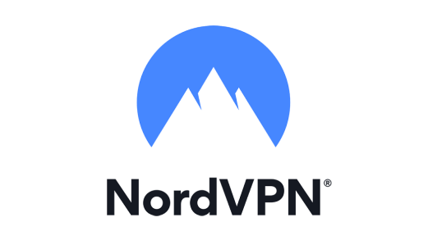

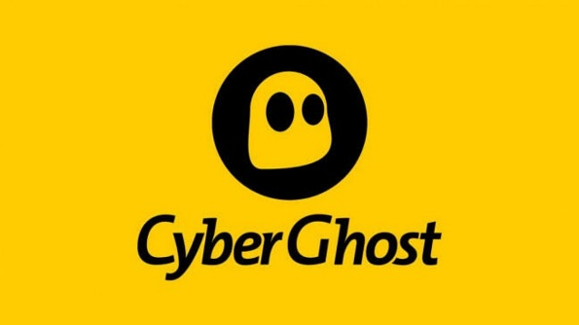
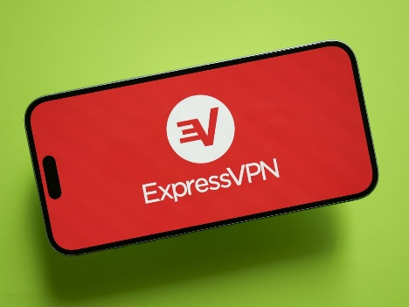

Popular VPN Services
NordVPN
Surfshark
CyberGhost
ProtonVPN
ExpressVPN

Slide 12
Ethernet
The Internet is a global network of interconnected computers that allows people and devices to communicate, share information, and access online services. It connects millions of networks worldwide, including businesses, governments, schools, and individuals.
This technology was invented by Bob and D.R. Boggs in the year 1970.
Ethernet connector is network interface card equipped with 48-bits MAC address.
A MAC address (Media Access Control address) is a unique identifier used in computer networks to recognize devices connected to the network. The MAC address consists of 12 hexadecimal characters (0-9 and A-F) and is used to identify each device on the network, such as a computer, phone, or router.
The MAC address is located in the hardware of the device, specifically in the network interface card (NIC). For example, a MAC address might look like this: 00:1A:2B:3C:4D:5E.
Device Identification: The MAC address allows a network to identify devices. This is crucial when connecting different devices to the network, such as routers, computers, or phones.

Slide 13
How Does the Internet Work?
Devices Connect to the Internet
  Computers, smartphones, and other devices connect using Wi-Fi, mobile data, or wired connections.
Data Travels Through Networks
  The internet works through a system of servers, routers, and cables that transmit data using the TCP/IP protocol.
Websites & Services Are Hosted on Servers
  Websites and online services (Google, YouTube, Facebook) are stored on powerful computers called servers.
You Access Information Using URLs & IP Addresses
  When you type a website address (like www.google.com), your browser connects to the website's IP address using the Domain Name System (DNS).
  DNS (Domain Name System) is a system used to translate domain names (such as website names) into IP addresses.
  DNS allows you to use names like www.google.com instead of the actual IP address of Google's server.

Slide 14
Virtual LAN
A VLAN (Virtual Local Area Network) is a logical network that allows devices to be grouped together, even if they are not physically connected to the same switch.
Introduction of switches to Ethernet has removed single collision domain issue and each device connected to switch works in its separate collision domain.
But even Switches cannot divide a network into separate Broadcast domains.
Host in one VLAN cannot speak to a host in another.

Slide 15
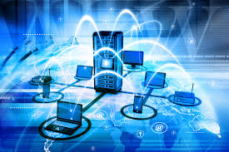
Network
A network is a collection of computers, servers, mainframes, network devices, and other devices connected to one another to allow the sharing of data and resources.
Networks can be as small as two computers connected to each other or as large as the internet, which connects millions of devices globally.

Slide 16
The Purpose of Networks
At one time, file-sharing consisted mostly of saving documents to floppy disks that could be physically transferred to other computers by hand.
With networking, however, files can be shared instantaneously across the network.
■ File sharing between two computers.
■ Surfing the web (for example, to use social media sites, watch streaming video, listen to an Internet radio station, or do research for a school term paper).
■ Messaging between computers.
■ E-mail.
■ Voice over IP (VoIP), to replace traditional telephony systems

Slide 17
Cont.……
A Network Transporting multiple types of traffic
for example
voice, video, and data is a converged network.

Slide 18
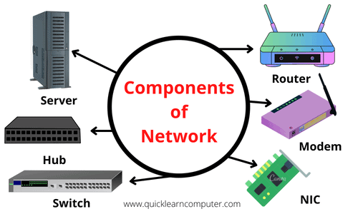
Network Components
A computer network is build up from several components. These components together makes it possible to transfer data from one device to another and makes smooth communication between two different devices. In this guide, we will discuss the main components of a computer network.

Slide 19
Server: Servers are computers that runs operating system and hold data that can be shared over a computer network.
Client: A client is a computer that is connected to other computers in the network and can receive data sent by other computers.
Transmission Media: All computers in a network are connected with each other through a transmission media such as wires Rj45, Rj11 , optical fiber cables, coaxial cables etc.
Network Interface card: Each system or computer in a network must have a card called network interface card (NIC). The main purpose of NIC is to format the data, send the data and receive the data at the receiving node.

Slide 20
Hub: Hub acts as a device that connects all the computer in a network to each other. Any request that comes from a client computer first received by Hub and then hub transmit this request over a network so that the correct server receives and respond to it.
Switch: Switch is similar to hub however instead of broadcasting a incoming data request it uses the physical device address in the incoming request to transfer the request to correct server computer.
Router: Router joins multiple computer networks to each other. For example lets say a company runs 100 computers over a local area network(LAN) and another company runs another LAN of 150 computers. These both LANs can be connected with each other through a internet connection which is provided by the router.
Cable: A wire that is used to connect more than one computers or other devices such as printers and scanner to each other.

Slide 21
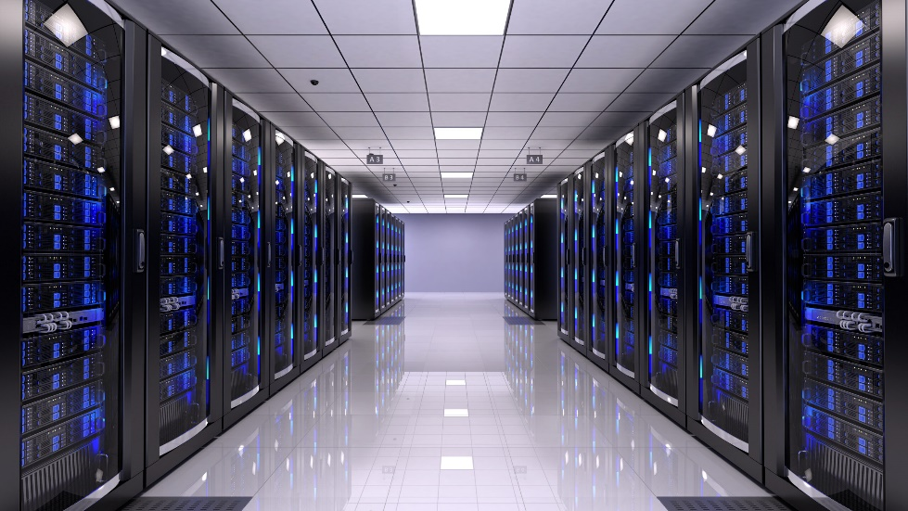
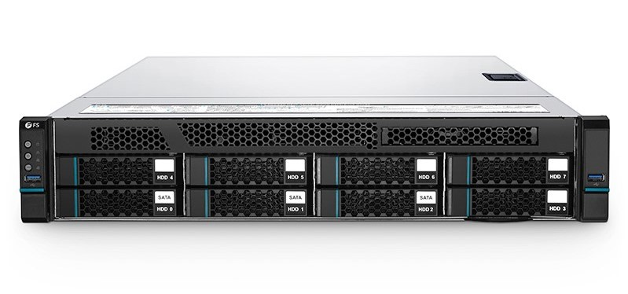
Server
Server: Servers are computers that runs operating system and hold data that can be shared over a computer network.

Slide 22

Client
Client: A client is a computer that is connected to other computers in the network and can receive data sent by other computers.

Slide 23
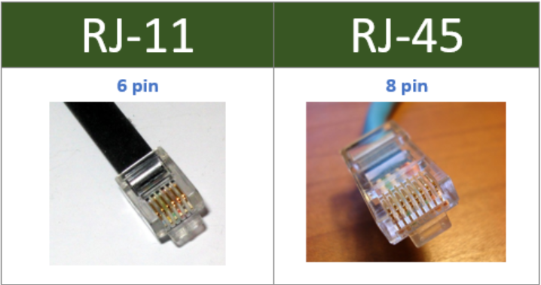
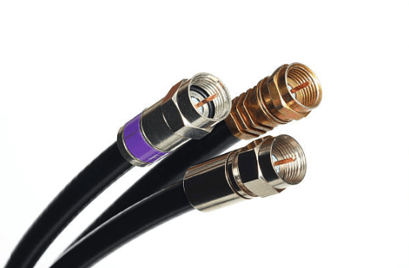
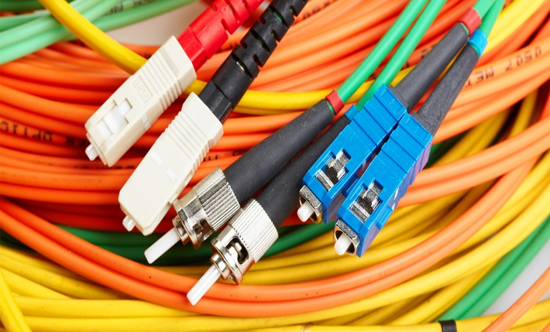
Transmission Media
Transmission Media: All computers in a network are connected with each other through a transmission media such as wires Rj45, Rj11 , optical fiber cables, coaxial cables etc.
RJ45 and RJ11
Coaxial Cables
Optical Fiber

Slide 24
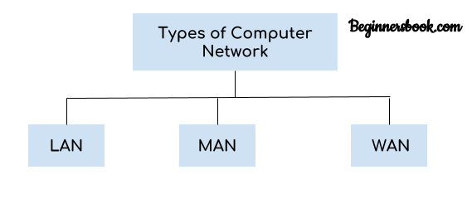
Classified Network.
Networks can be classified into various categories, including the following:
■ Local-area network (LAN)
■ Wide-area network (WAN)
■ Metropolitan-area network (MAN)
■ Personal-area network (PAN)
■ Campus-area network (CAN)

Slide 25
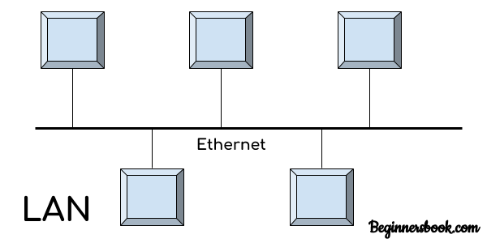
Local-area network (LAN)
Local area network is a group of computers connected with each other in a small places such as school, hospital, apartment etc.
LAN is secure because there is no outside connection with the local area network thus the data which is shared is safe on the local area network and can’t be accessed outside.
LAN due to their small size are considerably faster, their speed can range anywhere from 100 to 100Mbps.
LANs are not limited to wire connection, there is a new evolution to the LANs that allows local area network to work on a wireless connection.

Slide 26
Advantages of LAN
Resource Sharing: LAN provides resource sharing such as computer resources like printers, scanners, modems, DVD-ROM drives, and hard disks can be shared within the connected devices. This reduces cost and hardware purchases.
Software Applications Sharing: In a Local Area Network, it is easy to use the same software in a number of computers connected to a network instead of purchasing the separately licensed software for each client a network.
Easy and Cheap Communication: Data and messages can easily be shared with the other computer connected to the network.
Centralized Data: The data of all network users can be stored on a hard disk of the central/server computer. This help users to use any computer in a network to access the required data.

Slide 27
Disadvantages of LAN
High Setup Cost: The initial setup costs of installing Local Area Networks is high because there is special software required to make a server. Also, communication devices like an Ethernet cable switches, hubs, routers, cables are costly.
Privacy Violations: The LAN administrator can see and check personal data files of each and every LAN user. More over, he can view the computer and internet history of the LAN user.
LAN Maintenance Job: Local Area Network requires a LAN Administrator because there are problems such as software installations, program faults or hardware failures or cable disturbances in Local Area Network. A LAN Administrator is required to maintain these issues.
Covers Limited Area: LANs are restricted in size they cover a small area like a single office, single building or a group of nearby buildings.

Slide 28
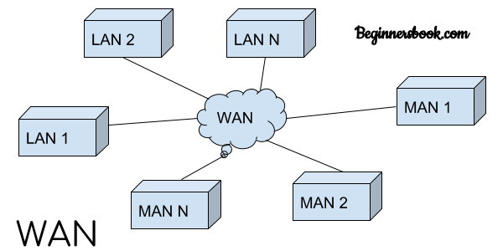
Wide-area network (WAN)
Wide area network provides long distance transmission of data. The size of the WAN is larger than LAN and MAN.
A WAN can cover country, continent or even a whole world. Internet connection an example of WAN. Other examples of WAN are mobile broadband connections such as 3G, 4G etc.

Slide 29
Advantages of WAN:
Centralized infrastructure: One of the main advantage of WAN is the that we do not need to maintain the backup and store data on local system as everything is stored online on a data center, from where we can access the data through WAN.
Privacy: We can setup the WAN in such a way that it encrypts the data that we share online that way the data is secure and minimizes the risk of unauthorized access.
Increased Bandwidth: With the WAN we get to choose the bandwidth based on we need, a large organization can have larger bandwidth that can carry large amount of data faster and efficiently.
Area: A WAN can cover a large area or even a whole world though internet connection thus we can connect with the person in another country through WAN which is not possible is other type of computer networks.

Slide 30
Disadvantages of WAN:
Antivirus: Since our systems are connected with the large amount of systems, there is possibility that we may unknowingly download the virus that can affect our system and become threat to our privacy and may lead to data loss.
Expensive: Cost of installation is very high.
Issue resolution: Issue resolution takes time as the WAN covers large area, it is really difficult to pin point the exact location where the issues raised and causing the problem.

Slide 31
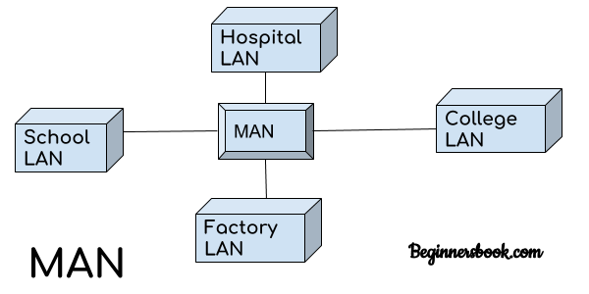
Metropolitan-area network (MAN)
MAN network covers larger area by connections LANs to a larger network of computers. In Metropolitan area network various Local area networks are connected with each other through telephone lines.
The size of the Metropolitan area network is larger than LANs and smaller than WANs(wide area networks), a MANs covers the larger area of a city or town.

Slide 32
Advantages of a metropolitan area network (MAN)
Less expensive: It is less expensive to attach MAN with WAN. MAN gives the good efficiency of data. In MAN data is easily managed in a centralized way.
Sending local emails: On MAN you can send local emails fast and free.
High speed than WAN: MAN uses fiber optics so the speed of data can easily reach upon 1000 Mbps. Files and databases can be transferred fast.
Sharing of the internet: In some installation of MANs, users can share their internet connection. So multiple users can get the same high-speed internet.
Conversion from LAN to MAN is easy: MAN is a faster way to connect two fast LANs together. This is due to the fast configuration of links.
High Security: MAN has a high-security level than WAN.

Slide 33
Disadvantages of metropolitan area network (MAN)
Difficult to manage: If MAN becomes bigger then it becomes difficult to manage it. This is due to a security problem and other extra configuration.
Internet speed difference: MAN cannot work on traditional phone copper wires. If MAN is installed on copper wires then there will be very low speed. So it required the high cost to set up fiber optics for the first time.
Hackers attack: In MAN there are high chances of attacking hackers on the network compared to LAN. So data may be leaked. Data can be secured but it needs high trained staff and security tools.
Technical people required to set up: to setup MAN it requires technical people that can correctly setup MAN. The technical people are network administrators and troubleshooters.

Slide 34
Network topology
Network topology refers to how various nodes, devices and connections on your network are physically or logically arranged in relation to each other.
There are two approaches to a network topology.
Physical network topology
Logical network topology

Slide 35
Physical network topology
Physical network topology refers to the actual physical layout of devices (computers, routers, switches, cables) in a network. It defines how devices are physically connected and how data flows between them.
Logical network topology
Logical network topology refers to how data flows between devices within a network, regardless of their physical connections. It defines the path data takes, how devices communicate, and how network protocols manage traffic.
Unlike physical topology, which focuses on the actual layout of devices and cables, logical topology is about data transmission, routing, and communication rules.

Slide 36
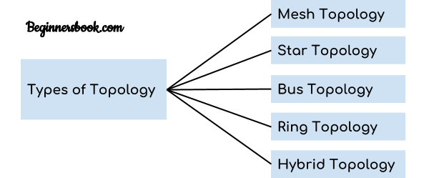
Types of network Topology
There are five types of topology
Bus
Ring
Star
Mesh
Hybrid

Slide 37
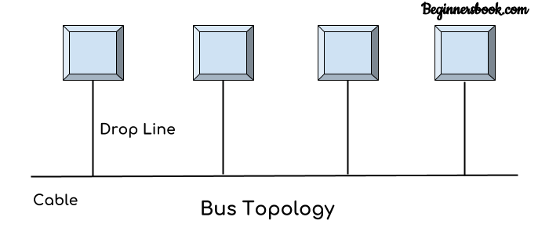
Bus
In bus topology there is a main cable and all the devices are connected to this main cable through drop lines. There is a device called tap that connects the drop line to the main cable. Since all the data is transmitted over the main cable, there is a limit of drop lines and the distance a main cable can have.
Advantages of bus topology
Easy installation, each cable needs to be connected with backbone cable.
Less cables required than Mesh and star topology
Disadvantages of bus topology
Difficultly in fault detection.
Not scalable as there is a limit of how many nodes you can connect with backbone cable.

Slide 38
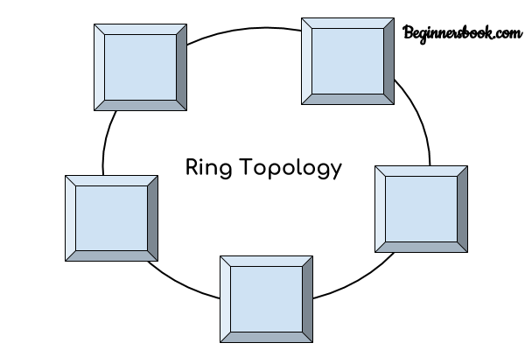
Ring
In ring topology each device is connected with the two devices on either side of it. There are two dedicated point to point links a device has with the devices on the either side of it. This structure forms a ring thus it is known as ring topology. If a device wants to send data to another device then it sends the data in one direction, each device in ring topology has a repeater, if the received data is intended for other device then repeater forwards this data until the intended device receives it.
Advantages of Ring Topology
Easy to install.
Managing is easier as to add or remove a device from the topology only two links are required to be changed.
Disadvantages of Ring Topology
A link failure can fail the entire network as the signal will not travel forward due to failure.
Data traffic issues, since all the data is circulating in a ring.

Slide 39
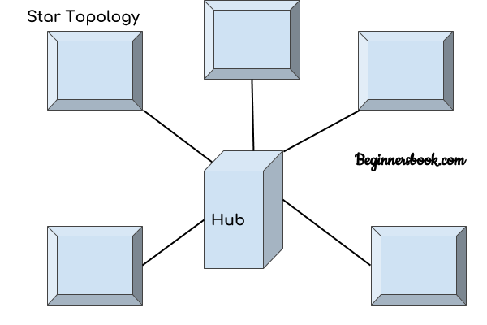
Star
In star topology each device in the network is connected to a central device called hub. Unlike Mesh topology, star topology doesn’t allow direct communication between devices, a device must have to communicate through hub. If one device wants to send data to other device, it has to first send the data to hub and then the hub transmit that data to the designated device.

Slide 40
Advantages of Star topology
Less expensive because each device only need one I/O port and needs to be connected with hub with one link.
Easier to install
Less amount of cables required because each device needs to be connected with the hub only.
Robust, if one link fails, other links will work just fine.
Easy fault detection because the link can be easily identified.
Disadvantages of Star topology
If hub goes down everything goes down, none of the devices can work without hub.
Hub requires more resources and regular maintenance because it is the central system of star topology.

Slide 41
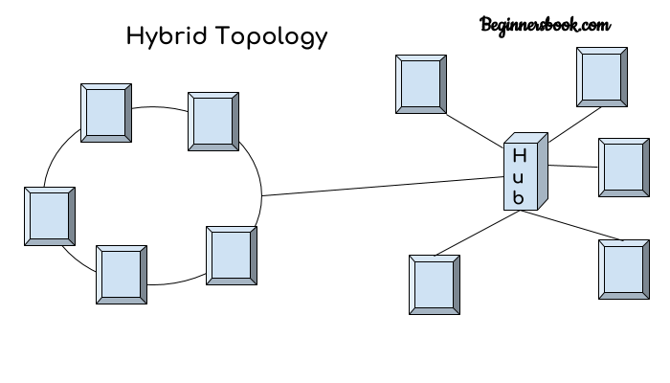
Hybrid
A combination of two or more topology is known as hybrid topology. For example a combination of star and mesh topology is known as hybrid topology.
Advantages of Hybrid topology
We can choose the topology based on the requirement for example, scalability is our concern then we can use star topology instead of bus technology.
Scalable as we can further connect other computer networks with the existing networks with different topologies.
Disadvantages of Hybrid topology
Fault detection is difficult.
Installation is difficult.
Design is complex so maintenance is high thus expensive.

Slide 42
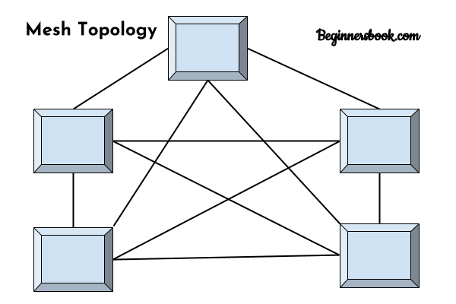
Mesh
In mesh topology each device is connected to every other device on the network through a dedicated point-to-point link. When we say dedicated it means that the link only carries data for the two connected devices only. Lets say we have devices in the network then each device must be connected with (n-1) devices of the network.

Slide 43
Advantages of Mesh topology
No data traffic issues as there is a dedicated link between two devices which means the link is only available for those two devices.
Mesh topology is reliable and robust as failure of one link doesn’t affect other links and the communication between other devices on the network.
Mesh topology is secure because there is a point to point link thus unauthorized access is not possible.
Fault detection is easy.
Disadvantages of Mesh topology
Amount of wires required to connected each system is tedious and headache.
Since each device needs to be connected with other devices, number of I/O ports required must be huge.
Scalability issues because a device cannot be connected with large number of devices with a dedicated point to point link.

Slide 44
OSI and TCP/IP Model.

Slide 45
OSI and TCP/IP Model.
OSI and TCP/IP are both logical models. One of the main similarities between the OSI and TCP/IP models is that they both describe how information is transmitted between two devices across a network.
OS I Model: It has 7 layers Physical layer, Data Link layer, Network layer, Transport layer, Session layer, Presentation layer, and Application layer. Each layer performs its task independently.
TCP/IP Model: It has 5 layers named as Physical layer, Data Link Layer, Network layer, Transport layer, and Application layer. It can also be used as a communications protocol in a private computer network.

Slide 46
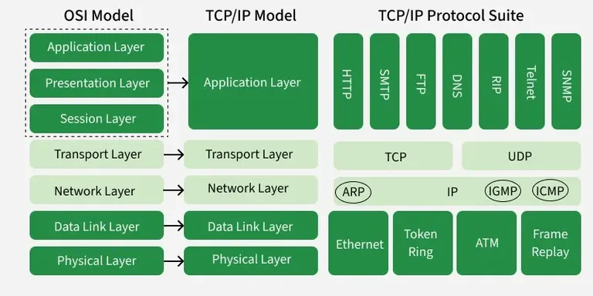

Slide 47
OSI Model
The OSI (Open Systems Interconnection) Model is a 7-layer conceptual framework used to understand and design network communication. Each layer has a clearly defined function and works independently of the others.
Physical Layer
Transmits raw bits over physical media.
Deals with cables, connectors, voltage levels, and data rates.
Data Link Layer
Provides node-to-node data transfer.
Handles MAC addressing, framing, and error detection.
  Examples: Ethernet, ARP
Address Resolution Protocol. ARP helps a computer find the MAC address of another device when it only knows the IP address, inside a local network (LAN).

Slide 48
Network Layer
Responsible for logical addressing and routing
Determines best path for data transmission
  Examples: IP, ICMP
Transport Layer
Ensures reliable or unreliable delivery of data
Manages flow control and error recovery
  Examples: TCP, UDP

Slide 49
Session Layer
Manages sessions between applications
Controls session establishment, maintenance, and termination
Presentation Layer
Translates, encrypts, and compresses data
Ensures data format compatibility
Application Layer
Provides network services to end-user applications
  Examples: HTTP, FTP, SMTP, DNS

Slide 50
TCP/IP Model
The TCP/IP (Transmission Control Protocol/Internet Protocol) Model is a 5-layer practical networking framework used for real-world communication, especially on the Internet.
It defines how data is packaged, addressed, transmitted, routed, and received across networks.
Network Access Layer
Combines OSI Physical and Data Link layers
Handles hardware addressing and physical transmission
  Examples: Ethernet, Wi-Fi

Slide 51
Internet Layer
Responsible for logical addressing and routing
  Examples: IP, ICMP, ARP
Transport Layer
Ensures end-to-end communication
  Examples: TCP, UDP
Application Layer
Combines OSI Session, Presentation, and Application layers
  Examples: HTTP, FTP, SMTP, DNS

Slide 52
Network Media and Topologies
1. Network Media
Network media are the physical or wireless pathways through which data travels between devices in a network. Choosing the right media is essential for performance, reliability, and scalability.
Types of Network Media
1. Wired Media
  Twisted Pair Cable (UTP/STP)
    Most common for LANs.
    UTP (Unshielded Twisted Pair) – cheaper, less protected from interference.
    STP (Shielded Twisted Pair) – has shielding to reduce electromagnetic interference.
        Examples: Cat5e, Cat6, Cat6a.

Slide 53
Coaxial Cable
Used in older networks and some broadband connections.
Resistant to interference, carries signals over longer distances.
Fiber Optic Cable
Transmits data as light pulses.
High speed, long-distance communication, immune to electromagnetic interference.
Types: Single-mode (long distance) and Multi-mode (shorter distance).
Wireless Media
Uses radio waves, microwaves, or infrared to transmit data.
Common wireless technologies: Wi-Fi (802.11), Bluetooth, LTE, 5G.
Advantages: Mobility, flexibility.
Disadvantages: Interference, security risks, limited distance.

Slide 54
END.

